Slide 1
Chapter 6
Multiplexing

Slide 2
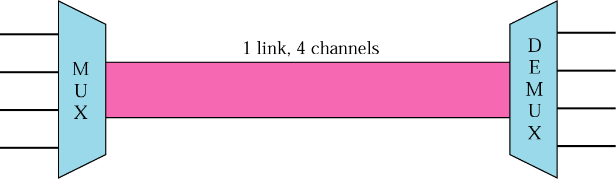
Figure 6.1 Dividing a link into channels

Slide 3
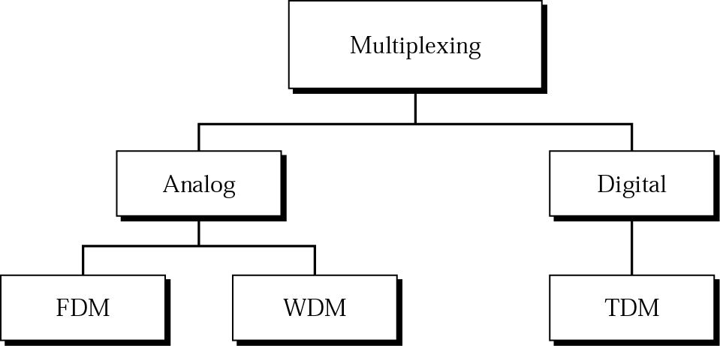
Figure 6.2 Categories of multiplexing

Slide 4
6.1 FDM
Multiplexing Process
Demultiplexing Process
The Analog Hierarchy
Other Applications of FDM
Implementation

Slide 5
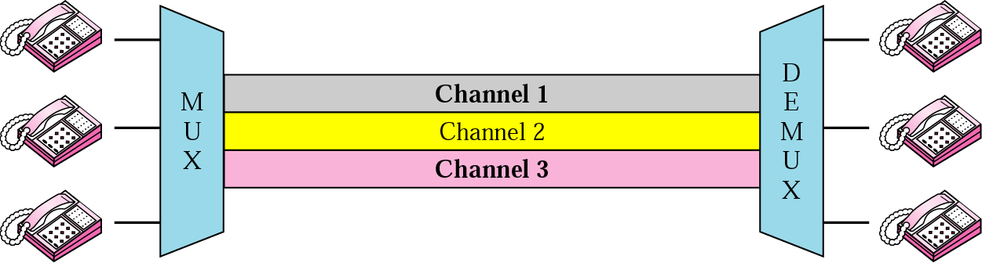
Figure 6.3 FDM

Slide 6

Note:
FDM is an analog multiplexing technique that combines signals.

Slide 7
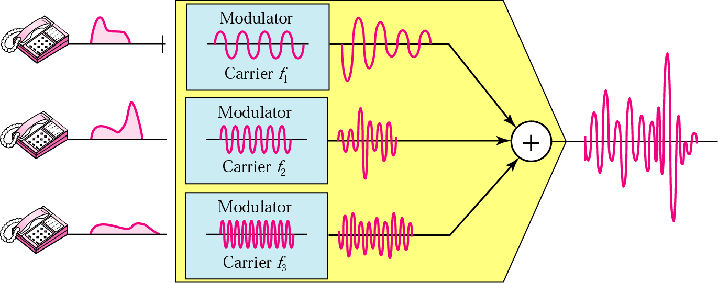
Figure 6.4 FDM process

Slide 8
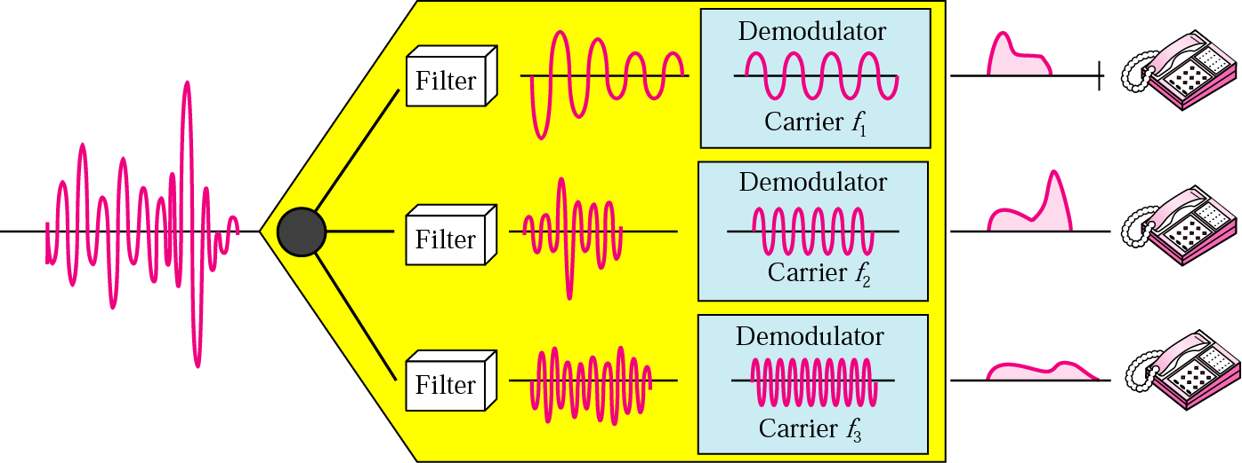
Figure 6.5 FDM demultiplexing example

Slide 9
Example 1
Assume that a voice channel occupies a bandwidth of 4 KHz. We need to combine three voice channels into a link with a bandwidth of 12 KHz, from 20 to 32 KHz. Show the configuration using the frequency domain without the use of guard bands.
Solution
Shift (modulate) each of the three voice channels to a different bandwidth, as shown in Figure 6.6.

Slide 10
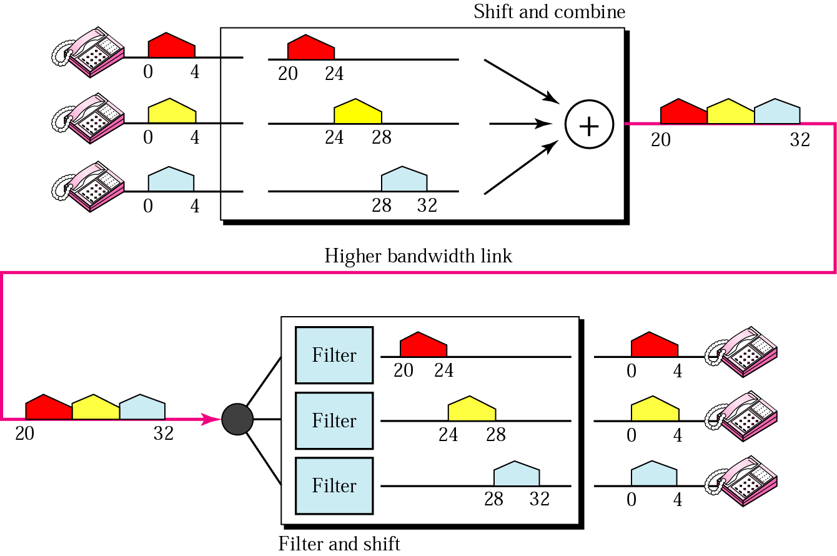
Figure 6.6 Example 1

Slide 11
Example 2
Five channels, each with a 100-KHz bandwidth, are to be multiplexed together. What is the minimum bandwidth of the link if there is a need for a guard band of 10 KHz between the channels to prevent interference?
Solution
For five channels, we need at least four guard bands. This means that the required bandwidth is at least
5 x 100 + 4 x 10 = 540 KHz,
as shown in Figure 6.7.

Slide 12
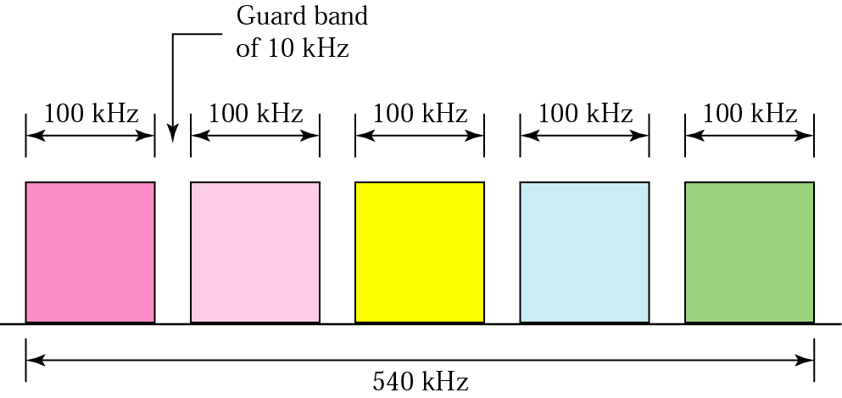
Figure 6.7 Example 2

Slide 13
Example 3
Four data channels (digital), each transmitting at 1 Mbps, use a satellite channel of 1 MHz. Design an appropriate configuration using FDM
Solution
The satellite channel is analog. We divide it into four channels, each channel having a 250-KHz bandwidth. Each digital channel of 1 Mbps is modulated such that each 4 bits are modulated to 1 Hz. One solution is 16-QAM modulation. Figure 6.8 shows one possible configuration.

Slide 14
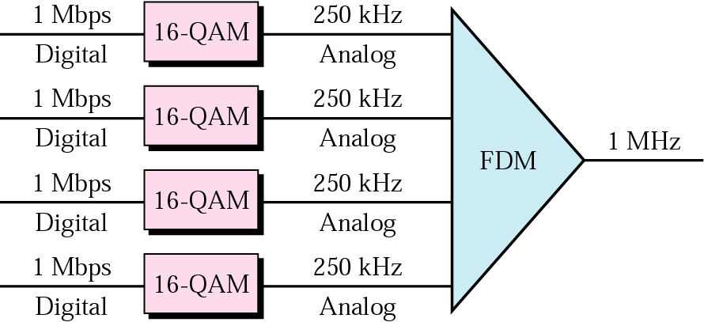
Figure 6.8 Example 3

Slide 15
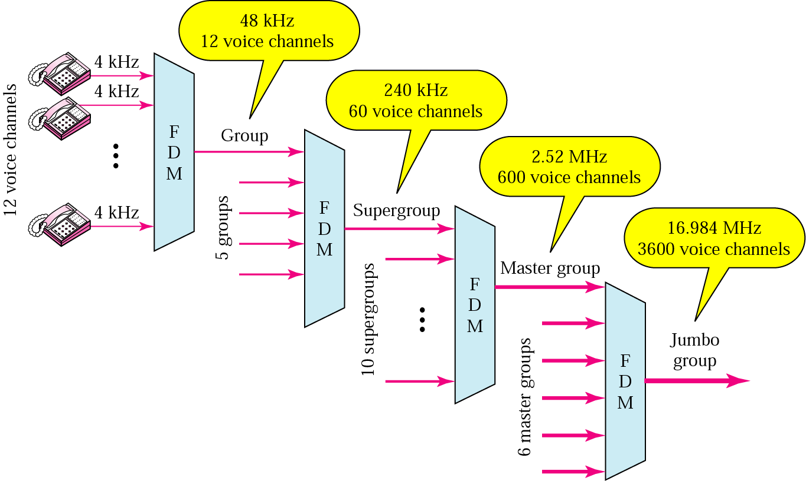
Figure 6.9 Analog hierarchy

Slide 16
Example 4
The Advanced Mobile Phone System (AMPS) uses two bands. The first band, 824 to 849 MHz, is used for sending; and 869 to 894 MHz is used for receiving. Each user has a bandwidth of 30 KHz in each direction. The 3-KHz voice is modulated using FM, creating 30 KHz of modulated signal. How many people can use their cellular phones simultaneously?
Solution
Each band is 25 MHz. If we divide 25 MHz into 30 KHz, we get 833.33. In reality, the band is divided into 832 channels.

Slide 17
6.2 WDM
Wave Division Multiplexing

Slide 18
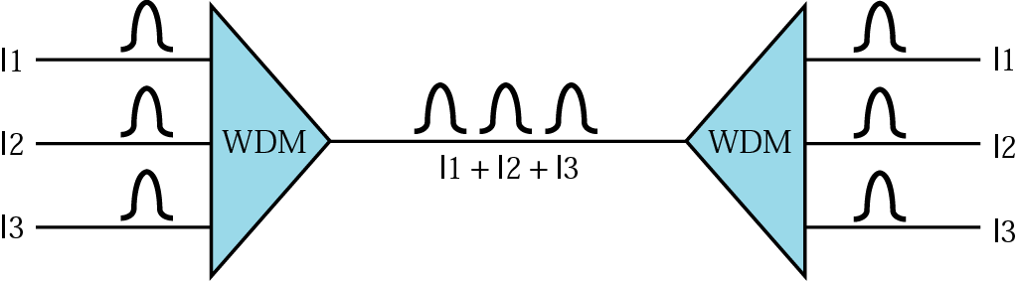
Figure 6.10 WDM

Slide 19
Note:
WDM is an analog multiplexing technique to combine
optical signals.

Slide 20
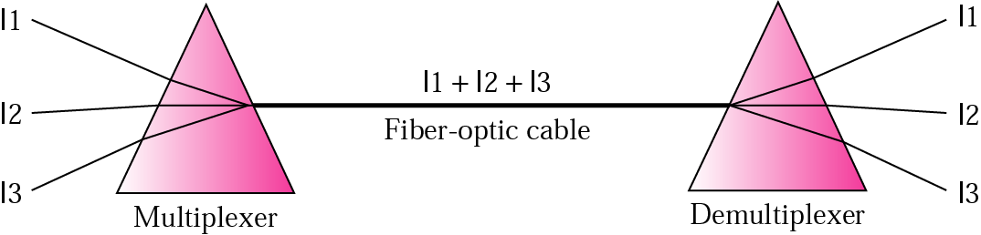
Figure 6.11 Prisms in WDM multiplexing and demultiplexing

Slide 21
6.3 TDM
Time Slots and Frames
Interleaving
Synchronizing
Bit Padding
Digital Signal (DS) Service
T Lines
Inverse TDM
More TDM Applications

Slide 22
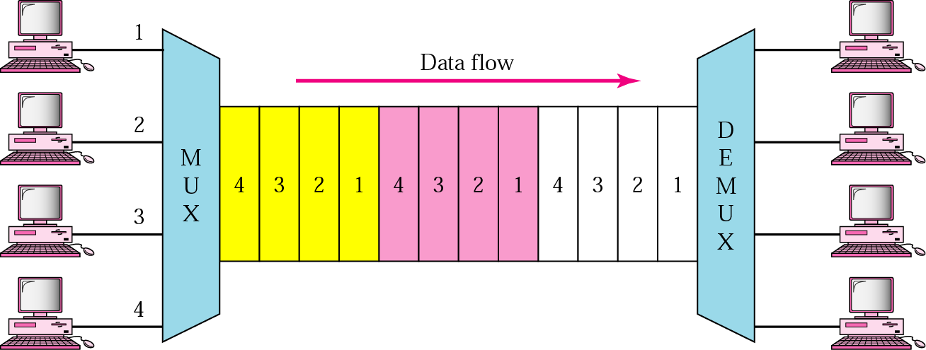
Figure 6.12 TDM

Slide 23
Note:
TDM is a digital multiplexing technique to combine data.

Slide 24
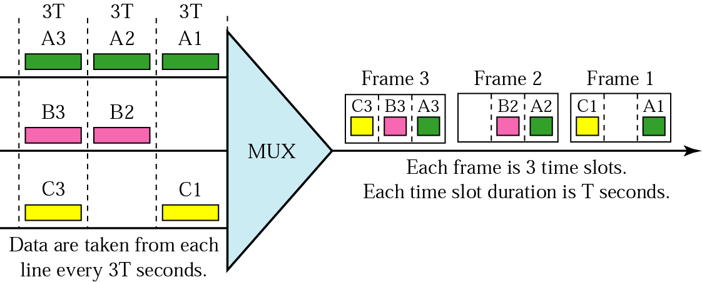
Figure 6.13 TDM frames

Slide 25
Example 5
Four 1-Kbps connections are multiplexed together. A unit is 1 bit. Find (1) the duration of 1 bit before multiplexing, (2) the transmission rate of the link, (3) the duration of a time slot, and (4) the duration of a frame?
Solution
We can answer the questions as follows:
1. The duration of 1 bit is 1/1 Kbps, or 0.001 s (1 ms).
2. The rate of the link is 4 Kbps.
3. The duration of each time slot 1/4 ms or 250 μs.
4. The duration of a frame 1 ms.

Slide 26
Note:
In a TDM, the data rate of the link is n times faster, and the unit duration is n times shorter.

Slide 27
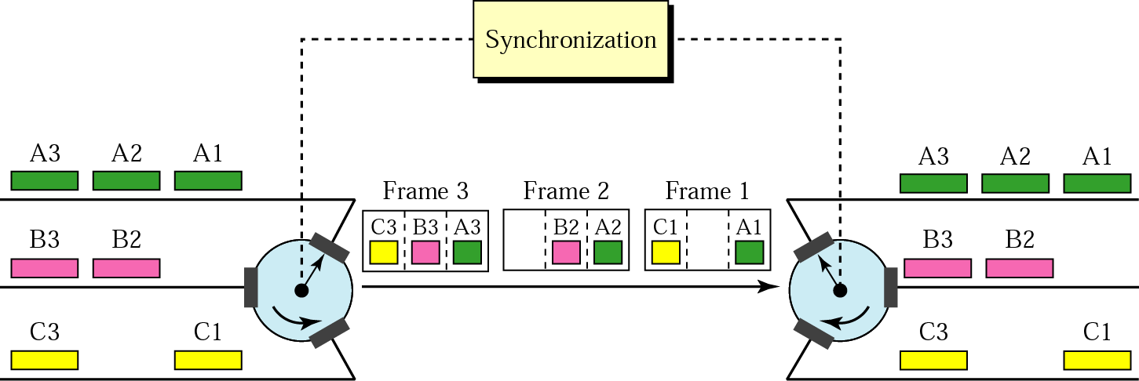
Figure 6.14 Interleaving

Slide 28
Example 6
Four channels are multiplexed using TDM. If each channel sends 100 bytes/s and we multiplex 1 byte per channel, show the frame traveling on the link, the size of the frame, the duration of a frame, the frame rate, and the bit rate for the link.
Solution
The multiplexer is shown in Figure 6.15.

Slide 29
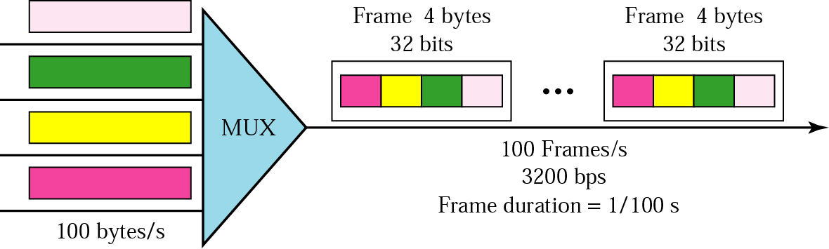
Figure 6.15 Example 6

Slide 30
Example 7
A multiplexer combines four 100-Kbps channels using a time slot of 2 bits. Show the output with four arbitrary inputs. What is the frame rate? What is the frame duration? What is the bit rate? What is the bit duration?
Solution
Figure 6.16 shows the output for four arbitrary inputs.

Slide 31
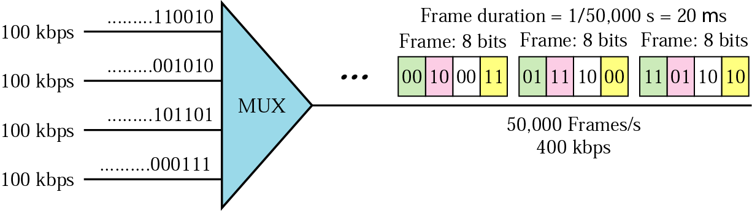
Figure 6.16 Example 7

Slide 32
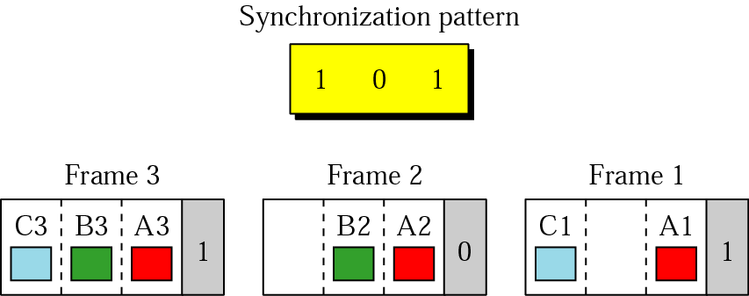
Figure 6.17 Framing bits

Slide 33
Example 8
We have four sources, each creating 250 characters per second. If the interleaved unit is a character and 1 synchronizing bit is added to each frame, find (1) the data rate of each source, (2) the duration of each character in each source, (3) the frame rate, (4) the duration of each frame, (5) the number of bits in each frame, and (6) the data rate of the link.
Solution
See next slide.

Slide 34
Solution (continued)
We can answer the questions as follows:
1. The data rate of each source is 2000 bps = 2 Kbps.
2. The duration of a character is 1/250 s, or 4 ms.
3. The link needs to send 250 frames per second.
4. The duration of each frame is 1/250 s, or 4 ms.
5. Each frame is 4 x 8 + 1 = 33 bits.
6. The data rate of the link is 250 x 33, or 8250 bps.

Slide 35
Example 9
Two channels, one with a bit rate of 100 Kbps and another with a bit rate of 200 Kbps, are to be multiplexed. How this can be achieved? What is the frame rate? What is the frame duration? What is the bit rate of the link?
Solution
We can allocate one slot to the first channel and two slots to the second channel. Each frame carries 3 bits. The frame rate is 100,000 frames per second because it carries 1 bit from the first channel. The frame duration is 1/100,000 s, or 10 ms. The bit rate is 100,000 frames/s x 3 bits/frame, or 300 Kbps.

Slide 36
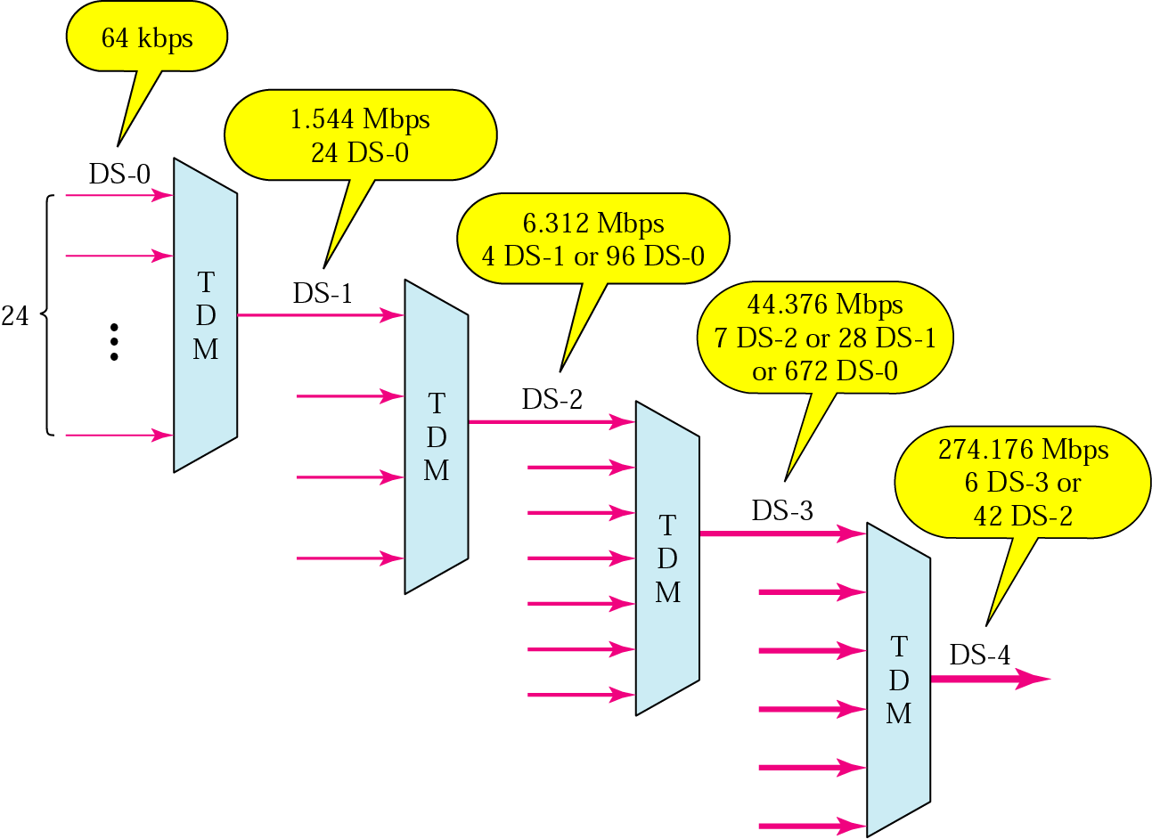
Figure 6.18 DS hierarchy

Slide 37
Table 6.1 DS and T lines rates
Service | Line | Rate (Mbps) | Voice Channels
DS-1 | T-1 | 1.544 | 24
DS-2 | T-2 | 6.312 | 96
DS-3 | T-3 | 44.736 | 672
DS-4 | T-4 | 274.176 | 4032

Slide 38
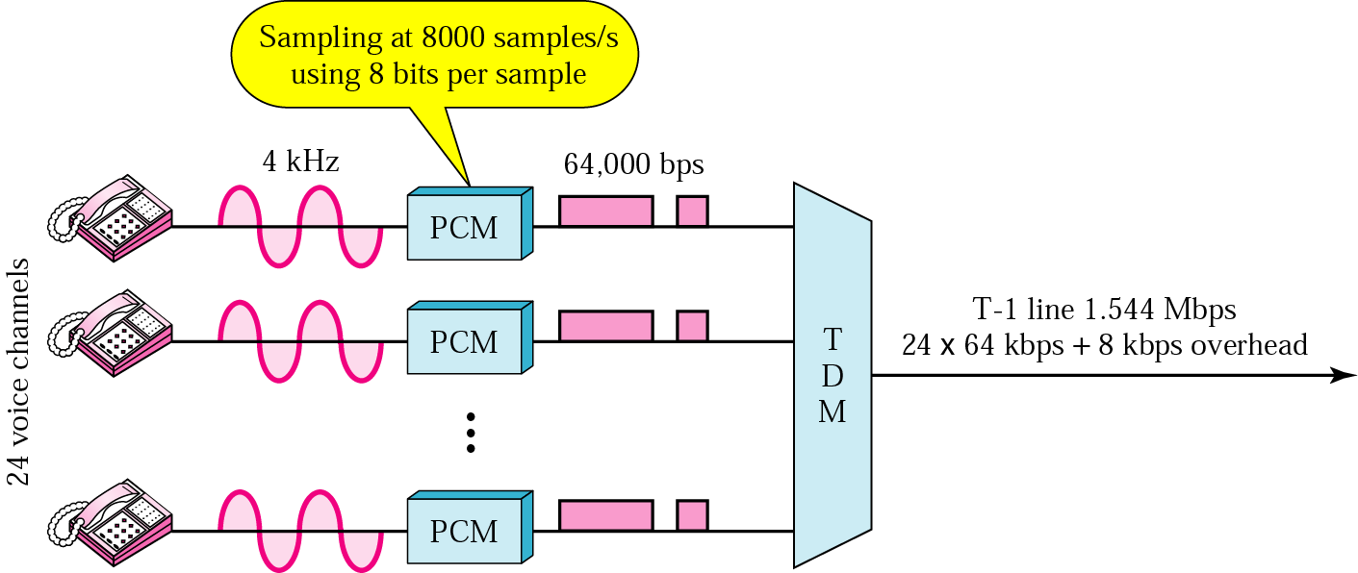
Figure 6.19 T-1 line for multiplexing telephone lines

Slide 39
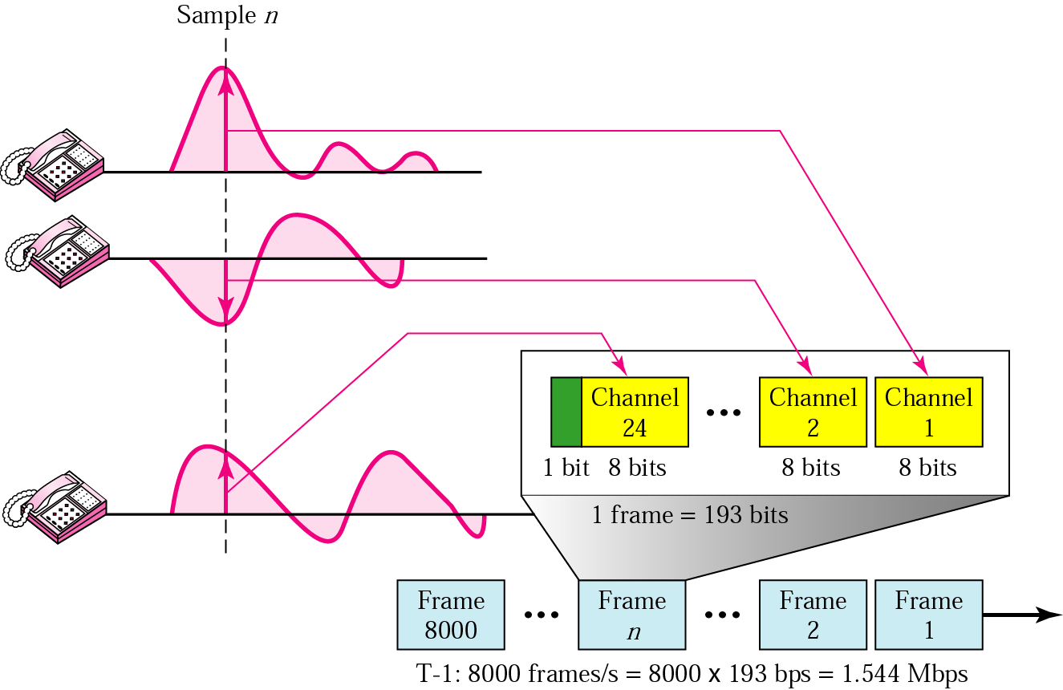
Figure 6.20 T-1 frame structure

Slide 40
Table 6.2 E line rates
E Line | Rate (Mbps) | Voice Channels
E-1 | 2.048 | 30
E-2 | 8.448 | 120
E-3 | 34.368 | 480
E-4 | 139.264 | 1920

Slide 41
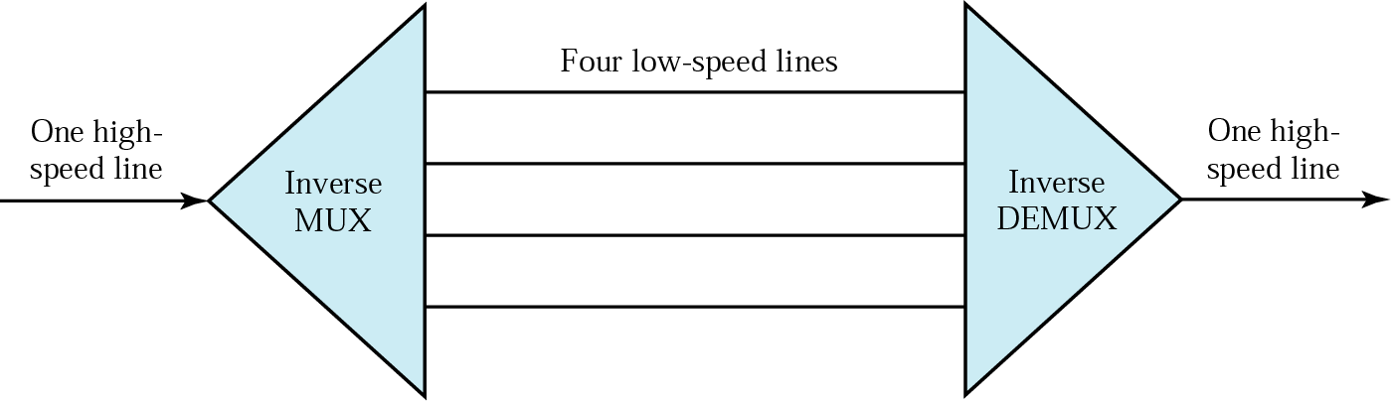
Figure 6.21 Multiplexing and inverse multiplexing

